Slide 1



Technical Facilities of Information
Prepared & Presented by: Mirlan Nurbekov, Lecturer
Office hours: Friday 9:00–17:00
AlaToo IT & Business College
Fall 2025

Slide 2
This presentation and all demonstration materials are provided solely for educational purposes to teach defensive cybersecurity practices, system hardening, and safe incident awareness. The content is intended to help students recognize threats and protect systems — not to instruct how to develop, deploy, or exploit malware. By participating in this class, students agree to use the information responsibly. The instructor and the institution do not authorize, condone, or accept responsibility for any unlawful, unethical, or unsafe actions taken by students based on information in this course. Any misuse of course content is the sole responsibility of the individual and may result in disciplinary and/or legal consequences.
If you are unsure whether an activity is permitted, stop and consult the instructor or your institution’s IT/security team before proceeding.

Slide 3


Understanding system vulnerabilities and cyber threats

Slide 4
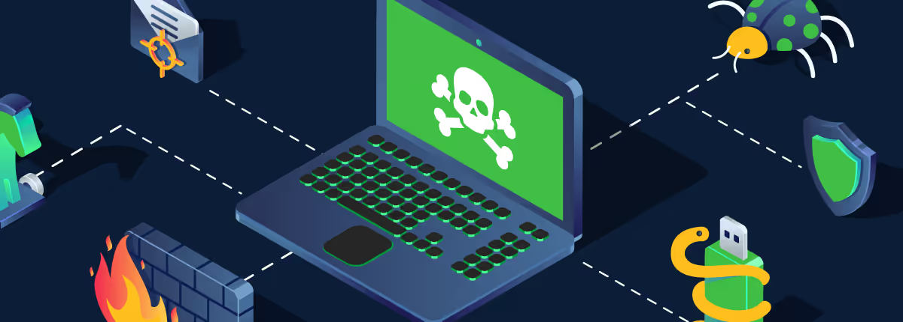
System vulnerabilities

Slide 5


System vulnerabilities
A vulnerability is a mistake or a weak spot in software, settings, or how people behave.

Slide 6

Why vulnerabilities exist

Slide 7
Why vulnerabilities exist
Complex software: lots of code → mistakes happen.
Human mistakes: weak passwords, wrong settings, or clicking bad links.
Old/unpatched software: updates fix bugs, but people delay installing them.
Third-party code: apps use libraries or packages that may have bugs.

Slide 8
How to use vulnerabilities?
Find a weakness (scan or guess).
Gain a tiny foothold (run code, open a backdoor, steal credentials).
Expand control (get higher privileges, move to other machines).
Harm or steal data (encrypt files, copy secrets, spy).

Slide 9
Common types of system vulnerabilities
Memory bugs -> Errors in how programs manage memory, example buffer overflow or memory leak. Attackers can exploit these to crash a system or run malicious code.
Injection fllaws -> u need to untrusted input is sent to a program or database, example SQL injection. Attackers can insert malicious commands to access or modify data.
Broken authentication ->weak login systems that allow attackers to impersonate users, example insecure passwords or poor session handling.

Slide 10
Common types of system vulnerabilities
Cross-site scripting (XSS) -> Attackers inject malicious scripts into web pages viewed by others. Used to steal cookies, sessions, or redirect users.
Cross-site request forgery (CSRF) -> Tricks a logged-in user into performing unwanted actions like changing passwords or sending data without consent.
Insecure configuration -> systems left with default settings, open ports, or unused services. These mistakes make it easier for attackers to gain access.

Slide 11
Common types of system vulnerabilities
Unvalidated input -> Failing to check or clean user input can cause crashes or allow malicious code to run, example accepting special characters in form fields
Privilege escalation -> Attackers exploit system flaws to gain higher access rights, example using a normal account to get admin control
Outdated or unpatched software -> old software versions with known bugs remain open to attack when updates are not applied

Slide 12
Common types of system vulnerabilities
Weak encryption -> using outdated or no encryption allows attackers to read sensitive data like passwords or financial information.
Social engineering -> manipulating people into revealing confidential information, example phishing emails or fake tech support calls.

Slide 13

Most common vulnerabilities
Memory bug - is a programming mistake that lets a program read or write the wrong part of memory — like a pointer pointing to the wrong shelf.
It is a root cause of many serious security incidents — they can let attackers crash services, steal data, or get deeper access.

Slide 14
Memory bug
Programs store data in memory (variables, lists, program code)
A memory bug happens when the program accesses memory it shouldn’t — too far, too little, or after it’s freed.
Common names you might hear: buffer overflow, use-after-free, null pointer dereference (don’t worry about the jargon — focus on the idea).

Slide 15
Why memory bugs occur?
Complex code: many lines, many edge cases; mistakes slip in.
Unsafe languages: languages like C/C++ give direct access to memory and require the programmer to manage it carefully.
Missing checks: program assumes input fits, but attackers supply unexpected sizes or timing.
Legacy code: old code written before modern protections, still running today.

Slide 16
How attackers generally take advantage (conceptual only)
Look for a program that accepts input (file, network, user) and has a memory bug.
Craft input that triggers the bug so the program behaves in an unexpected way.
If unchecked, that unexpected behavior can be turned into control over the program.

Slide 17
For defence - mitigations
Think of memory like labeled boxes. A memory bug is when a program puts something into the wrong box or reads a box that’s already been thrown away. That sounds small, but attackers can sometimes turn that tiny mistake into a big problem. We defend against these with safer coding practices, automatic protections built into modern OSes, and by keeping software patched.

Slide 18
For defence - mitigations
Keep software up to date — patches fix known bugs.
Use safer languages (when possible) or use safe libraries that check bounds.
Employ OS-level protections: ASLR (randomize memory), DEP/NX (prevent executing data), stack canaries.
Code reviews and testing: fuzzing, static analysis, and unit tests find bugs before release.
Least privilege: run programs with minimal rights so a compromised program has limited impact.

Slide 19
Privilege escalation
Privilege escalation is when a user or program gains higher access rights than they should have — for example, a regular user getting administrator (Windows) or root (Linux) powers. Computers separate what different accounts and programs are allowed to do. If something or someone can "level up" their permissions, they can do more damage or access sensitive data. If an attacker or a buggy program gets higher privileges, they can change system files, install persistent tools, or read private data.

Slide 20
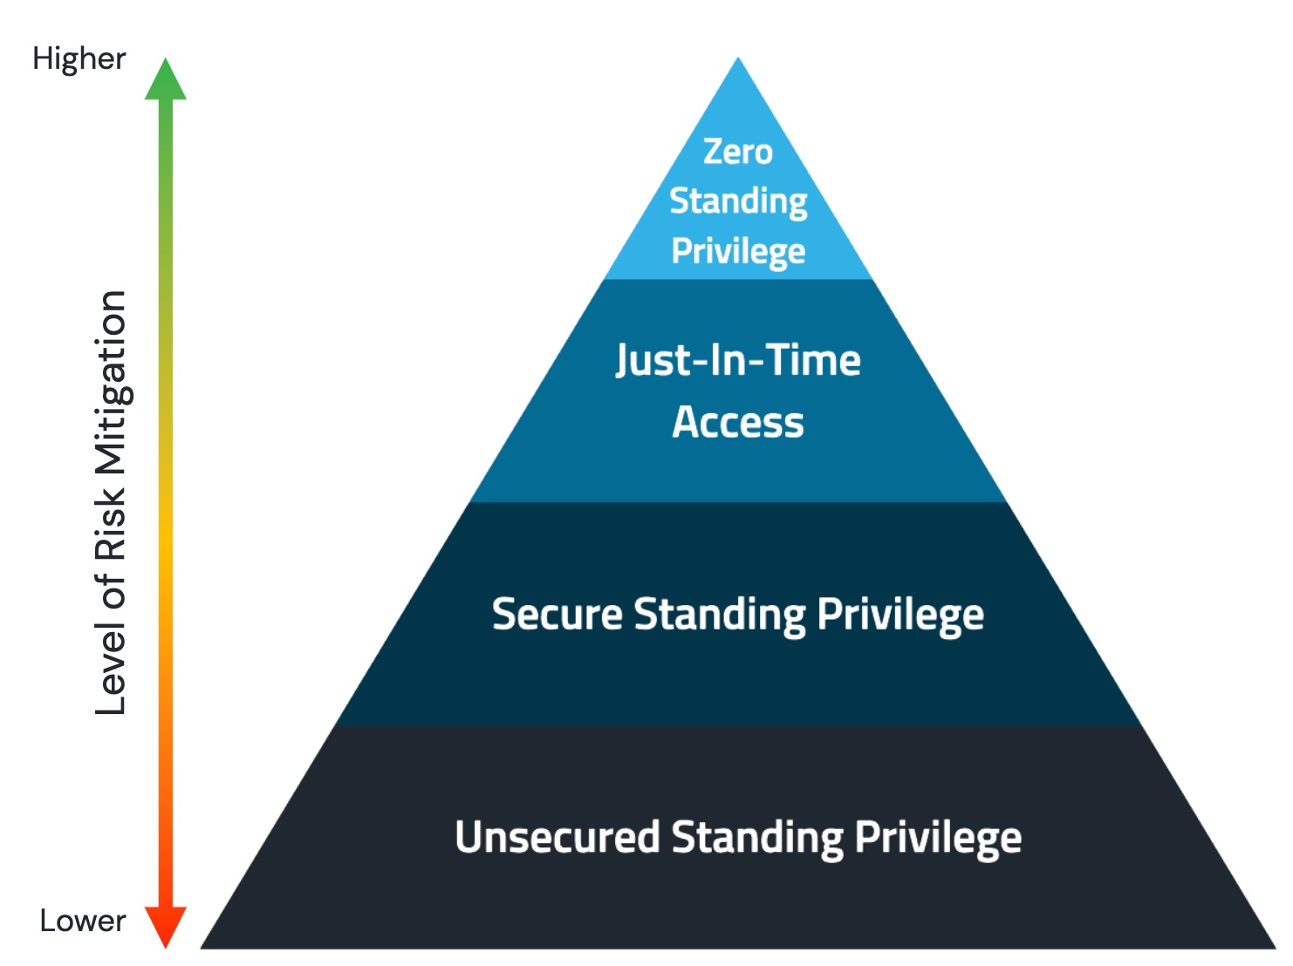
High privilege system level access

Slide 21
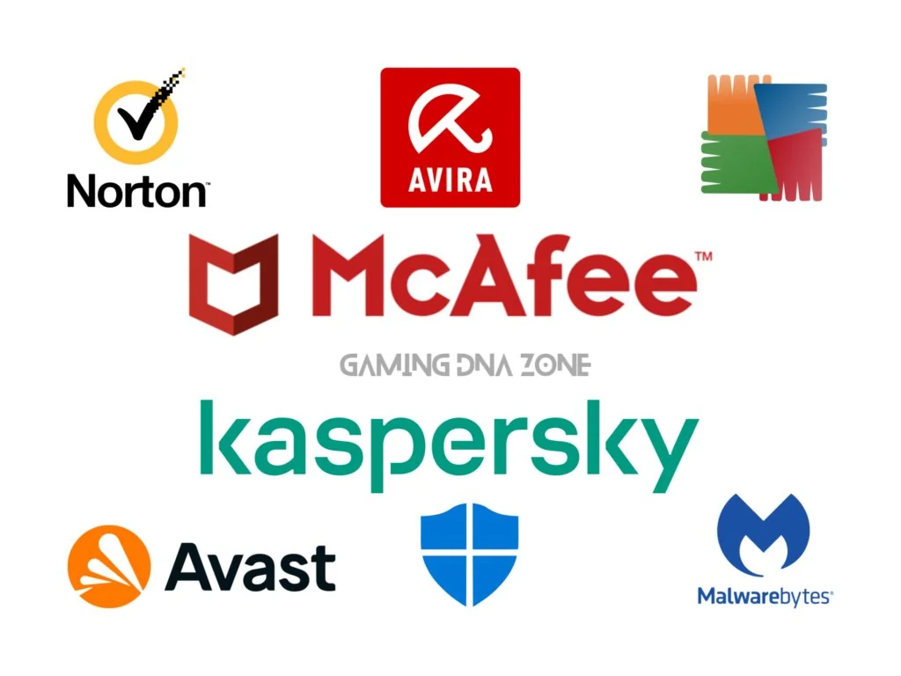
Antivirus

Slide 22
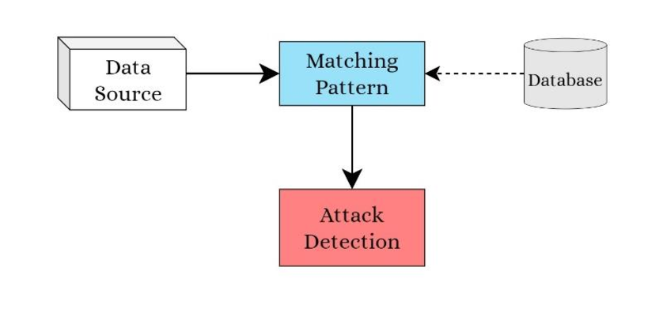
Signature-based detection
Identify the content of the file

Slide 23
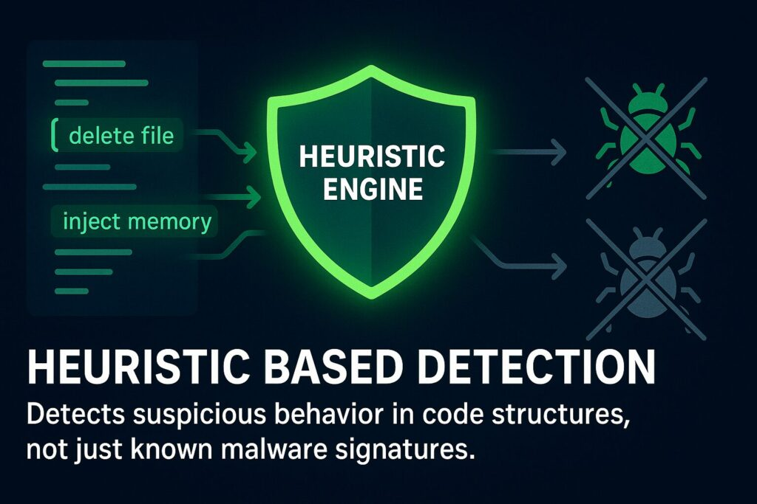
Heuristic-based detection

Slide 24
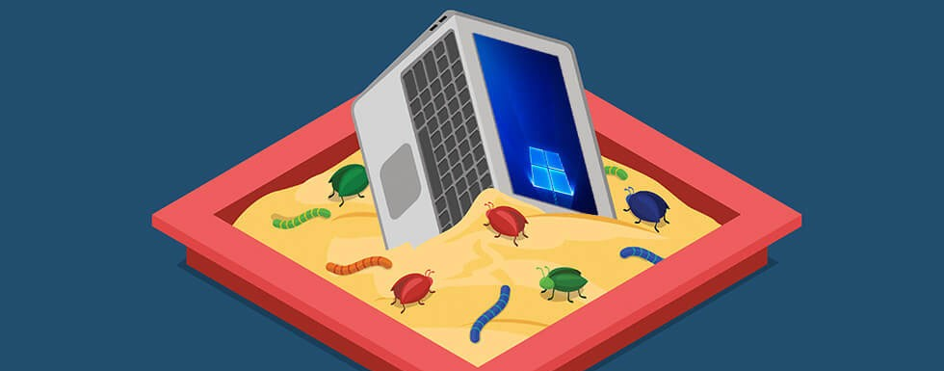
Sandbox

Slide 25
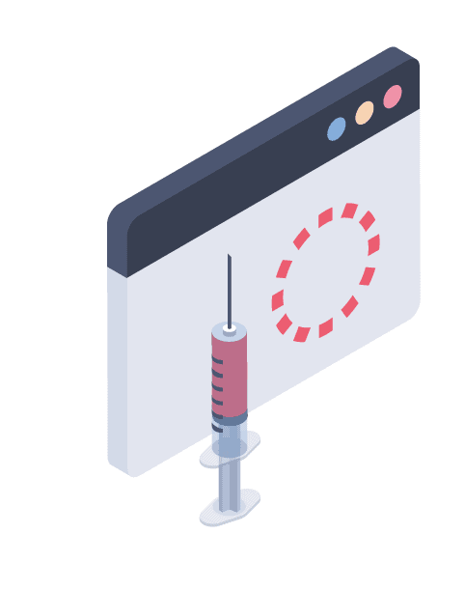

Techniques for attacks

Slide 26
Techniques for attacks
Phishing -> sending fake emails or messages that look legitimate to trick users into revealing passwords or clicking malicious links. Example: a fake bank email asking you to “verify” your account.
Spear phishing -> targeted phishing aimed at a specific person or organization using personal details to appear more convincing. Example: an email that uses a colleague’s name and job details.
Man-in-the-Middle (MitM) -> Intercepting and possibly altering communication between two parties without their knowledge. Example: an attacker on public Wi-Fi capturing login credentials.

Slide 27
Techniques for attacks
Brute-force attack -> try every possible password or key until one works. Works when passwords are short or weak.
Dictionary attack -> trying a list of common words/passwords (a “dictionary”) against an account to guess the password faster than a pure brute-force.
Keylogging -> installing software or hardware that records keystrokes to capture passwords and messages. Example: a malicious program logging everything typed.
Malware delivery (trojan/ransomware/worm) -> send malicious software that gives attackers control, encrypts files, or spreads across systems. Example: ransomware encrypting files and demanding payment.

Slide 28
Techniques for attacks
supply-chain - compromising a trusted third-party vendor or update so malware reaches many users through legitimate software or hardware. Example: a malicious update pushed through a vendor.
Distributed denial of service (DDoS) -> flooding a server or network with traffic from many sources to make it unavailable. Example: botnet-generated traffic taking a website offline.
Watering hole -> compromising websites frequently visited by a target group so visitors get infected. Example: infecting an industry forum to reach employees of target companies.

